Slide 1
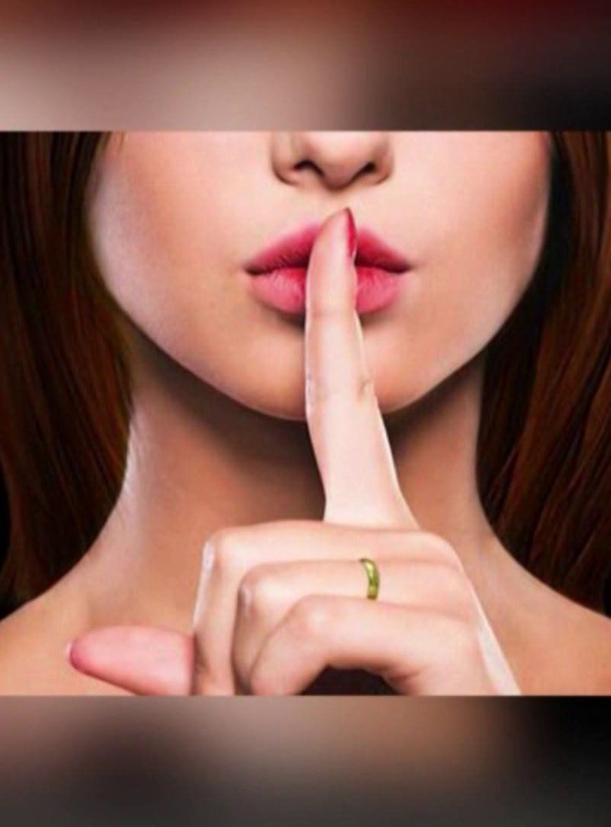
The Ashley Madison Hack
In 2015, a website built on the promise of discretion unraveled in one of the most infamous data breaches in history. Ashley Madison—a platform designed to cater to individuals seeking extramarital affairs or those entertaining advances from others—marketed itself as a safe haven for secrecy. Users trusted the site to protect their darkest desires and confidential meetups, believing their privacy was impenetrable.
By Kayla Rada
Notes:
Read slide Let’s put yourself in the user’s shoes for a moment. Would you hope for the site’s closure, knowing that in an industry as profitable as this, another company would surely rise to take its place?
Would you on the other hand, would you feel a sense of vindication that your suspicions about a partner’s involvement on the site might finally explain those untraceable expenses or suspicious behaviors?
What about the possibility of devastation so profound that some might even consider ending their lives, the weight of secrets, guilt, and the potential loss of family ties, pushing some users to consider tragic actions.

Slide 2


The Rise of Ashley Madison
1
2001: Foundation
Darren Morgenstern founds Ashley Madison in Toronto, Canada, targeting a niche market of married individuals seeking affairs.
5–10 credits (roughly $5) just to send a message.
That didn’t include the more expensive features like sending “virtual gifts” or using “priority mail” which further increased the males spending.
100 credits for approximately $50
500 credits for $150
1,000 credits for $250
2
Token-based system
The credit purchasing system was based on what Ashley Madison called a “token-based” credit system rather than the straightforward subscription system we see today.
3
2007: Acquisition
Avid Life Media acquires Ashley Madison, bringing in Noel Biderman as CEO to drive aggressive growth.
Notes:
READ SLIDE
Morgenstern drawing off data around the 2000s that suggested up to 30% of users on conventional dating sites were already married or in relationships and saying “80 % of men and 50% of women will cheat on their spouses at some point. It’s ingrained in our DNA, and it’s not going to change anytime soon
So, he sought to create a platform where people could act on their desires without facing judgment.
The credit purchasing system was based on what Ashley Madison called a “token-based” credit system
READ SLIDE
“Traveling Man” feature, which allowed users to connect with people in other locations
“Priority Mail” system, which gave a message a priority placement in the receiver’s inbox
“Virtual Gifts,” which were just intangible virtual items to rack up more profits for the business.
However, one of the more controversial aspects of the site was its “Full Delete” feature, which promised users that for a fee of $19 USD to delete their profiles. This service was marketed as a way for users to ensure their privacy, its effectiveness would come into question later.

Slide 3
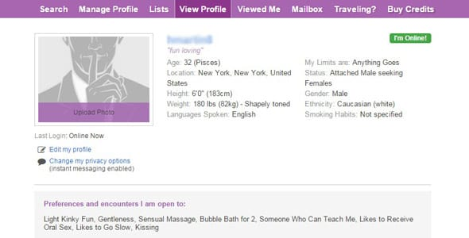

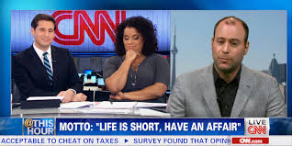
The Rise of Noel Biderman
1
2007: Noel to be CEO
Avid Life Media acquires Ashley Madison, bringing in Noel Biderman as CEO to drive aggressive growth.
2
Bold Moves
Under Biderman, the platform adopted a bold and unapologetic approach to advertising by using bold statements and alluring messages
3
2015: Peak
Ashley Madison reaches over 37 million users across 40 countries, with bold marketing and controversial tactics.
Notes:
Ashley Madison was slow to gain traction when it first launched. Exact numbers on the site’s early user base are difficult to pinpoint, but estimates suggest that only a few hundred thousand people had been signed up before the site was sold to Avid Life Media in 2007.
However, a pivotal shift occurred that transformed the company’s slow-burn trajectory, largely thanks to one man: Noel Biderman.
when major networks began rejecting their provocative ads by deciding to market to U.S. audiences by targeting cable networks that allowed more leeway in terms of what could be said and shown. Creating their tagline, “Life is short. Have an affair” or “Your wife doesn’t need to know”
Noel even quotes “Were not creating anything that isn’t already out there. We’re simply providing a platform for those who already have a desire to cheat and were doing so in a safe and discrete manner.”
By 2015, Ashley Madison had skyrocketed to over 37 million users and was widely used in more than 40 countries. This growth was largely attributed to Biderman’s leadership and the company’s willingness to use unconventional tactics.

Slide 4
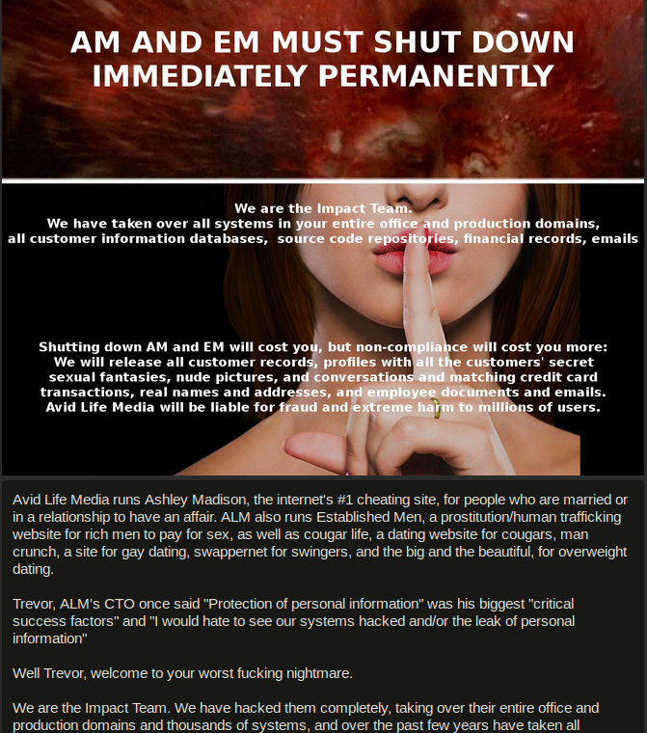
The Hack: Day One
1
July 19, 2015: Initial Breach
2
Immediate Response
Employees arrive to find threatening messages from "The Impact Team" on their computers.
Ashley Madison's leadership initially treats the threat as a bluff, bringing in cybersecurity experts to investigate.
3
30-Day Ultimatum
The Impact Team demands Ashley Madison and Established Men be shut down permanently within 30 days.
Notes:
On the morning of July 19, 2015, around 200-250 employees arrived for what they thought would be a typical day at the office. However, things quickly took a turn as they walked to their respective desks. They were told not to touch their computers - not like there was an option, as every computer in the facility was greeted by a chilling message from a hacker group calling themselves The Impact Team. The ominous message read: READ SCREEN
For some, there was a sense of disbelief that such a targeted attack could occur. Others worried about what this breach meant for their personal security, as the hackers also threatened to release internal employee details. At first, Ashley Madison’s leadership treated the hacker’s threat as little more than a bluff. With no explicit ransom or further communication from The Impact Team, the company assumed it might be a scare tactic rather than a genuine breach.
To address the issue, CEO Noel Biderman brought in top-tier cybersecurity experts to investigate. Their goal was to assess the extent of the intrusion and determine whether any data had been compromised.
However, the lack of urgency in the company’s approach may have stemmed from a desire to downplay the incident, particularly with an Initial Public Offering (IPO) on the horizon.

Slide 5
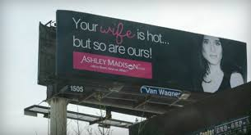
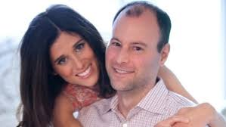
Human Error
1
Built on a foundation
2
Noel Biderman sucks
Ashley Madison’s marketing was built on a foundation of discretion and “trust”—ironic given the site’s purpose.
Biderman took this narrative to a personal level. Known for his brash confidence, he publicly defended the site every chance he got.
3
IPO on the horizon
The IPO was pivotal to Ashley Madison’s strategy to gain legitimacy.
Notes:
READ SLIDE
Transactions for Ashley Masion services were deliberately obscured on credit card statements, appearing under unrelated business names to prevent suspicion. The customer service team was trained to deflect calls from suspicious spouses, advising them to dispute charges with their credit card companies. The entire operation was a well-oiled machine designed to help users hide in plain sight. (Paton, 2024)
READ SLIDE
Biderman often presented himself alongside his wife, who vouched for his personal faithfulness, framing their relationship as proof the platform was not a cause of infidelity. However, this confidence ultimately became his downfall.
By projecting himself as a symbol of trustworthiness and loyalty, he made the company’s promises of privacy and discretion feel genuine. And yet, when the Impact Team’s threat finally came to a head, Biderman’s confidence would be revealed as a fraud, and the site’s promises would fall apart in the most public way possible.
Biderman envisioned it as an opportunity to reframe the company’s reputation. By going public, the IPO could have provided the financial muscle to grow and improve its technology infrastructure.
For Biderman and other insiders, this could have represented a financial return. If the IPO went through, it could have been seen as a double-edged sword, a chance for growth, but also it would have spotlighted its vulnerabilities.
In the end, the hack not only derailed these ambitions but also highlighted the risks Biderman was willing to take to legitimize Ashley Madison.

Slide 6



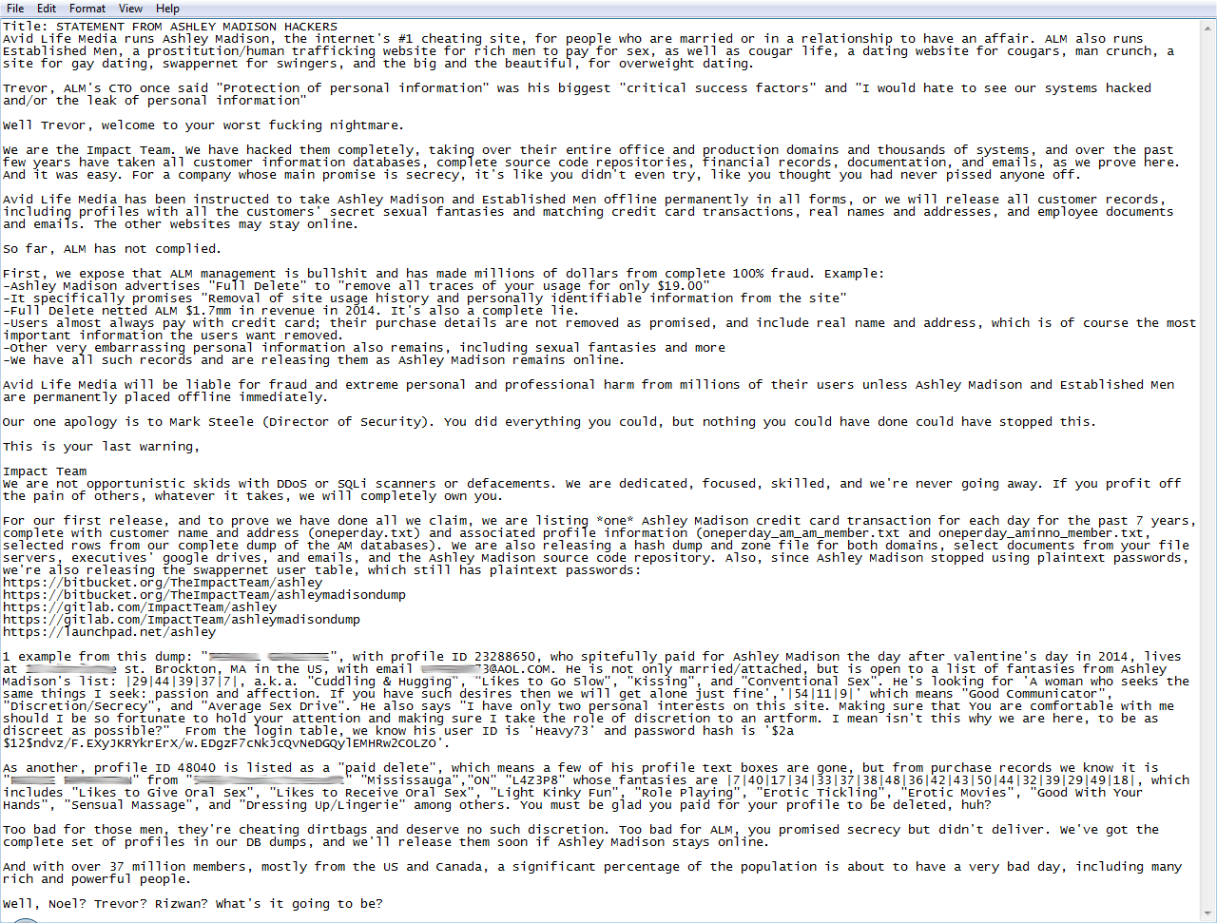

The Fallout Begins
July 19th, 2015
A reporter named Brain Krebs broke the story, revealing that a group of hackers, known as The Impact Team, has collected around 40 MB of sensitive data from Avid Life Media.
July 20th, 2015
Both Avid Life Media and the Impact Team made statements
July 22nd, 2015
The group publicly exposed two Ashley Madison users, a man from Brockton, MA, and a man from Ontario, Canada
Notes:
READ SLIDE
Noel Biderman speculated that the breach might have been an inside job or by someone who “touched” ALM’s IT system.
On July 20^{th,}, Avid Life Media made a public statement saying they were aware of an attempt to gain access to their systems.
SLIDE
I know you can’t read all this so Ill shorten it up
We are the Impact Team. We hacked them completely... over the past few years have taken all customer information databases, complete source code repositories, financial records, documentation, and emails, as we prove here. And it was easy. For a company, whose main promise is secrecy, it’s like you didn’t even try, like you thought you had never pissed anyone off.”
How upset the team is that ALM lied about the “Full Delete” option and how “ALM netted $1.7 million in revenue in 2014” from this feature, and it’s a complete lie.
The team did apologize to Mark Steel (Director of Security). “You did everything you could, but nothing you could have done could have stopped this.” Going on they advised this was the last warning, leaving the statement with, “Well, Noel? Trevor? Rizwan? What’s it going to be?”
READ SLIDE
In the days following the ultimatum, the Impact Team escalated their threats.
Exposing their email, address, fantasies, log-in ID, and full password hash. Further demonstrating that they not only had the data but also knew how to analyze it.
On August 18th, 2015, Impact Team’s 30-day window ultimatum expired, but of course, both Ashley Madison and Established Men are still online. In another Pastebin post titled “TIMES UP!” The team releases the first significant portion of Ashley Madison’s user data dump. Using a torrent file containing 10 GB of the users’ emails, physical addresses, fantasies, hashed passwords, and credit card information. Avid Life Media released a statement acknowledging the breach, stating they “were working with authorities to investigate, and claiming the hackers were not “hacktivists” but criminals.” (Wikipedia). In the following days of August 19th-20th “search websites” started popping up that let users search to see if their email addresses were leaked. The first data dump exposed the personal details of millions of users, triggering a media frenzy as individuals and news outlets scoured the lists for recognizable names.
On August 20th, 2015, the Impact Team leaks a second major dump of the AM data. Unlike the first release on the 18th this one contained around 60 GB of the user’s data. This dump was mostly internal data, including Avid Life Media CEO Noel Biderman’s emails and Ashley Madison’s website source code. In total, the hack exposed over 37 million users. The consequences were swift and severe, as the leak led to public shame, intense scrutiny, and unrecoverable damage to reputations. The companies would soon see multiclass action lawsuits, and soon the company would also offer a $500,000 reward for information on the Impact team or the attack.

Slide 7
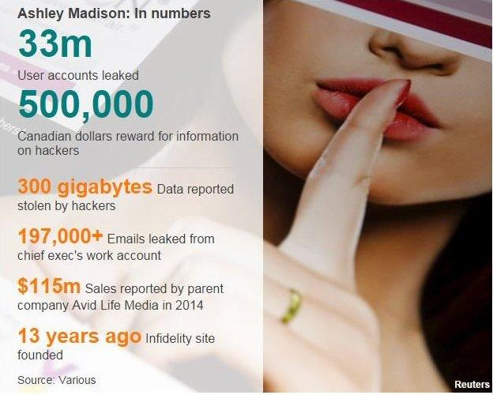
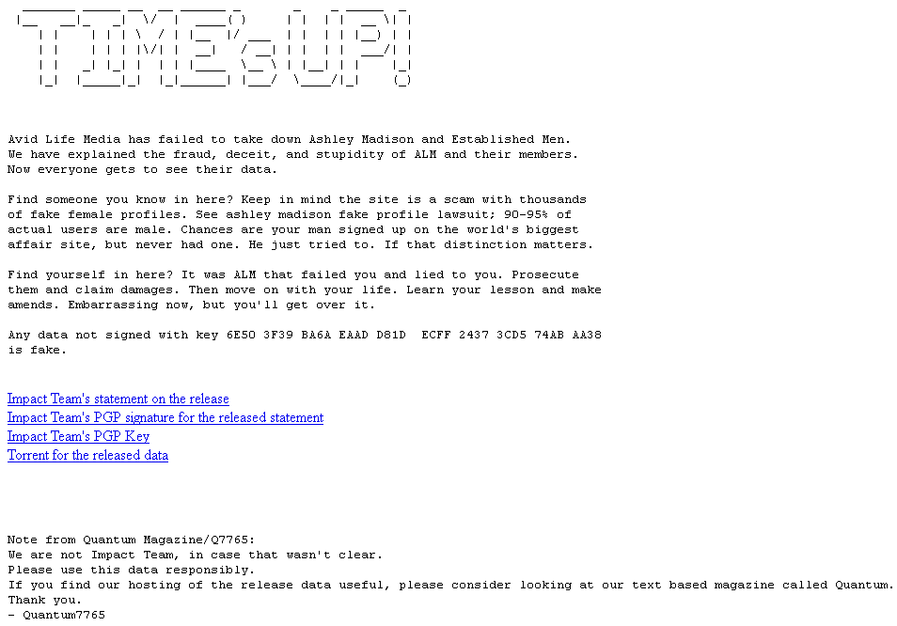
The Fallout Begins
August 18th, 2015
Impact Team’s 30-day window ultimatum expired, but of course, both Ashley Madison and Established Men are still online.
Times Up!
The team releases the first significant portion of Ashley Madison’s user data dump. Using a torrent file containing 10 GB of the user's data.
August 20th, 2015
Impact Team leaks a second major dump of the AM data. Unlike the first release on the 18th this one contained around 60 GB of the user’s data.
Notes:
READ SLIDE
READ SLIDE
In another Pastebin post titled “TIMES UP!” Using a torrent file containing 10 GB of the users’ emails, physical addresses, fantasies, hashed passwords, and credit card information.
Avid Life Media released a statement acknowledging the breach, stating they “were working with authorities to investigate, and claiming the hackers were not “hacktivists” but criminals.” (Wikipedia). In the following days of August 19th-20th “search websites” started popping up that let users search to see if their email addresses were leaked. The first data dump exposed the personal details of millions of users, triggering a media frenzy as individuals and news outlets scoured the lists for recognizable names.
READ SLIDE
This dump was mostly internal data, including Avid Life Media CEO Noel Biderman’s emails and Ashley Madison’s website source code.
In total, the hack exposed over 37 million users. The consequences were swift and severe, as the leak led to public shame, intense scrutiny, and unrecoverable damage to reputations.
The companies would soon see multiclass action lawsuits, and the company would also offer a $500,000 reward for information on the Impact team or the attack.

Slide 8



The Human Cost
Reputations Ruined
Relationships Destroyed
High-profile individuals exposed, including YouTube personalities and reality TV stars.
Marriages and families torn apart as infidelities were revealed on a massive scale.
Tragic Outcomes
Reports of suicides linked to the exposure, highlighting the devastating personal impact.
Notes:
Beyond the individual lives shattered by the breach, the data dump revealed deeper issues within Ashley Madison itself. Just a week after the first major dump, reports of blackmail and identity theft were starting to target the leaked Ashley Madison users.
On August 28th, 2015, Noel Biderman, whose emails were leaked in the second data dump, stepped down,
One of the most significant revelations was the discrepancy between the advertised number of active female users, which was far lower than advertised.
From an article from Gizmodo, “out of 5.5 million female accounts, roughly zero percent show any kind of activity at all, after the day they were created. ”(Annalee Newitz 2015)
many of the women the male users believed they were chatting with were not real individuals, but bots or even Ashley Madison employees.
This revelation was devastating to male users who had been spending large sums of money on tokens to message these supposedly interested women or to access explicit images, only to find out their interactions were manipulated by the company to increase profits.
Some of the most high-profile individuals revealed in the breach included the YouTube couple Sam and Nia Rader, who had built their family channel around their love and faith. When Sam’s account on the site was exposed, their channel was banned, and their public image suffered.
Reality star Josh Duggar from 19 Kids and Counting also found himself in the spotlight, eventually issuing a public apology and revealing his personal life struggles after the attack.
Rumors circulated that other prominent individuals, including Hunter Biden and various government officials, were on the list, though some of these claims remain unverified or hidden.
Reports linked two suicides, one of a pastor and another of a professor at the New Orleans Baptist Theological Seminary, to the data leak. Both their families reportedly cited the exposure as a driving factor. Unconfirmed reports mentioned two additional suicides in Toronto, Canada, and one in the United States.

Slide 9
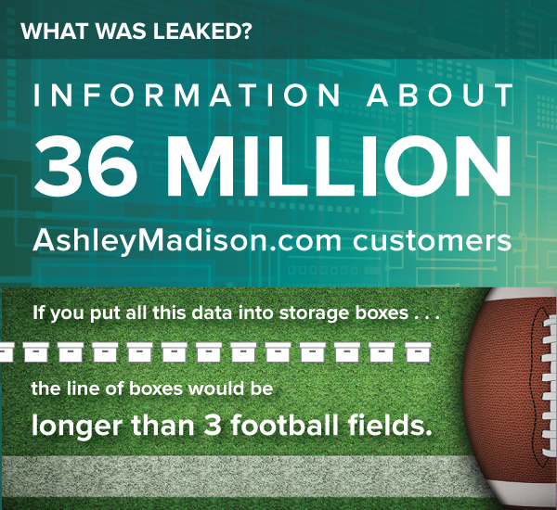
The Impact Team
“We are not opportunistic skids with DDoS or SQLi scanners or defacements. We are dedicated, focused, skilled, and were never going away. If you profit off the pain of others, whatever it takes, we will completely own you.”
Motivations
The hackers claimed ethical motivations, criticizing Ashley Madison's deceptive practices and profiting from pain. They aimed to expose the company's inner workings and spark a reckoning.
Methods
Using sophisticated techniques like Tor for anonymity, the Impact Team took a calculated approach. They didn't demand ransom, instead focusing on exposing Ashley Madison's practices and leadership.
Notes:
From the start it was clear this was more than a typical data heist; it was a calculated and deeply personal attack targeting the company’s practices and leadership.
So, why Ashley Madison? The Impact Team hadn’t hacked before and hasn’t been active since. They claimed ethical motivations, criticizing Avid Life Media’s (ALM) deceptive practices. But security experts were divided on their true intentions.
Like Robert Graham of Errata Security, suggested it was about the thrill: “They appear to be motivated by the immorality of adultery, but in all probability, their motivation is that #1 it’s fun and #2 because they can,”
Norwegian researcher Per Thorsheim, pointed to timing, noting that ALM had been moving toward an IPO just before the hack. “It’s not just for the fun and ‘because we can,’ nor is it just what I would call ‘moralistic fundamentalism.” “Given that the company had been moving toward an IPO right before the hack went public, the timing of the data leaks was likely no coincidence.”
In an interview between The Impact Team and with Joseph Cox on Vice.com on August 21st, 2015, the team only agreed to answer questions via email. Q&A below.
How did you hack Avid Life Media? Was it hard? The Impact Team: “We worked hard to make fully undetectable attack, then got in and found nothing to bypass.”
What was their security like? “Bad. Nobody was watching. No security. Only thing was segmented network. You could use Pass1234 from the internet to VPN to root on all servers.”
When did you start hacking them? Years ago? “A long time ago.”
What were your motivations for the hack? “We were in Avid Life Media a long time to understand and get everything. Finally we watched Ashley Madison signups growing and human trafficking on the sites. Everyone is saying 37 million! Blackmail users! We didn’t blackmail users. Avid Life Media blackmailed them. But any hacking team could have. We did it to stop the next 60 million. Avid Life Media is like a drug dealer abusing addicts.”
How experienced are the hackers in The Impact Team? “Very.”
Will The Impact Team be hacking any other sites in the future? If so, what targets or sort of targets do you have in mind? “Not just sites. Any companies that make 100s of millions profiting off pain of others, secrets, and lies. Maybe corrupt politicians. If we do, it will be a long time, but it will be total.”
In 2014, ALM reported revenues of $115 million, a figure that made one thing clear, the company was never going to bow to demands or shut down.
For the Impact Team, this was never about negotiation, it was about making a statement and letting the fallout unfold.

Slide 10
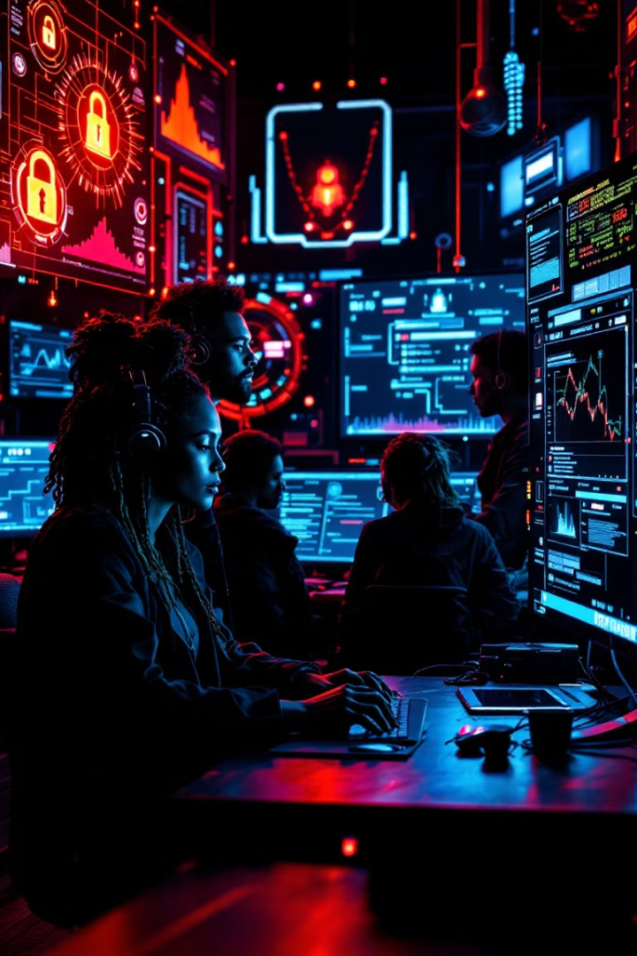


Lessons Learned
SQL Injection
Weak Passwords
Social Engineering
Spear Phishing and Malware
Complex Layered Attack
Insider Threat
Unpatched Vulnerabilities
Poor Security Culture
HOW????
Enhanced Security
Companies must adopt comprehensive security measures, including strong encryption and network segmentation.
User Education
Educating users on digital safety and encouraging strong passwords and multi-factor authentication is crucial.
Ethical Practices
Transparency about data management and adhering to ethical standards is essential for building trust.
Notes:
The Ashley Madison hack was a wake-up call for the digital age, showing just how devastating a data breach can be when sensitive user information isn’t properly protected.
ALM rebranded to Ruby Corp. in July 2016 in attempts to rebuild its image, also distancing themselves from their controversial slogan, “Life is show, have an affair” shifting to “open-minded relationships”
By July of 2017, Ruby Corp. paid out $11.2 million settlement to compensate the victims. Rebuilding trust and improving data security took not just them but another financial investment, and it’s a sobering reminder how critical it is to get cybersecurity right from the start.
So, what else went wrong? According to CynoSure Prime, a password-cracking group, Ashley Madison didn’t prioritize strong encryption methods, leaving over 11 million passwords vulnerable.
Many of those passwords were laughably weak, think like “123456”, which only made matters worse.
On top of that, the company’s network lacked the property segmentation and monitoring, giving attackers free rein to explore their systems without being detected for far too long.
Theories on How Ashley Madison Was Hacked
SQL Injection: Exploiting poorly monitored subdomains to retrieve sensitive data, possibly including admin password reset codes.
Weak Passwords: Corporate accounts used simple passwords like "Pass1234," making them easy targets for brute force or social engineering.
Social Engineering (SE): Employees may have been manipulated into revealing access credentials.
Spear Phishing and Malware: Targeted emails may have infected a developer’s machine, enabling network access.
Complex Layered Attack: A combination of SQL injection and malware deployment, though considered less likely due to complexity.
Insider Threat: A disgruntled employee or someone with internal access may have facilitated the breach.
Unpatched Vulnerabilities: Gaps in system updates may have provided entry points for hackers.
Poor Security Culture: The company’s lax approach, such as weak password policies, contributed to the overall vulnerability.
These theories emphasize a combination of technical weaknesses and human errors, possibly exploited together, to achieve the hack.

Slide 11



Moving Forward
Shared Responsibility
1
Cybersecurity is everyone's concern, from C-suite to end-users.
Continuous Improvement
2
Regular security audits and updates are essential.
Ethical Leadership
3
Prioritizing user trust and privacy in business decisions.
For companies, it’s clear: cybersecurity isn’t just an IT issue, it’s a company wide responsibility. And for users, it’s a call to take ownership of your online safety. It in an interconnected world, protecting privacy and trust is a shared effort, and the lessons from Ashley Madison's breach will continue to share how we approach digital security.
Notes:
What can we learn from all this? If the Ashley Madison hack happened today, could it be prevented? Thankfully cybersecurity practices have advance significantly since 2015, and several modern measures could mitigate or even prevent such an attack:
Stronger Password Policies: Enforcing complex, unique passwords and eliminating defaults like "Pass1234" would have significantly raised the bar for attackers. Modern systems use password managers, combined with tools like password entropy checks, to minimize weak credentials.
Multifactor Authentication (MFA): MFA could have added an extra layer of security, even if passwords were compromised. Attackers would need access to a second factor, such as a user’s phone or hardware token, to proceed.
Improved Network Segmentation: Proper segmentation limits the damage of a breach by restricting lateral movement within the network. If ALM had segmented sensitive data from less critical systems, attackers wouldn’t have been able to access everything so easily.
Real-Time Monitoring and Intrusion Detection: Advanced monitoring tools, such as SIEM (Security Information and Event Management) systems and AI-driven anomaly detection, can identify suspicious activity quickly and alert administrators before significant damage occurs.
Zero Trust Architecture: Adopting a Zero Trust model ensures that no user or system is trusted by default, requiring continuous verification of identity and permissions to access data or systems.
For companies, it’s clear: cybersecurity isn’t just an IT issue, it’s a company wide responsibility. And for users, it’s a call to take ownership of your online safety. It in a interconnected world, protecting privacy and trust is a shared effort, and the lessons from Ashley Madison’s breach will continue to share how we approach digital security.

